Slide 1


Slide 2
Chapter 4
Completing the
Accounting Cycle

Slide 3
Chapter Outline
Learning Objectives
LO 1 Prepare a worksheet.
LO 2 Prepare closing entries and a post-closing trial balance.
LO 3 Explain the steps in the accounting cycle and how to prepare correcting entries.
LO 4 Identify the sections of a classified statement of financial position.

Slide 4
The Worksheet
Multiple-column form used in preparing financial statements
Not a permanent accounting record
May be a computerized worksheet
Prepared using a five step process
Use of worksheet is optional
LO 1

Slide 5
Yazici Advertising Worksheet For the Month Ended October 31, 2020
 | Trial Balance |  | Adjustments |  | Adjusted Trial Balance |  | Income Statement |  | Statement of Financial Position
Account Titles | Dr. | Cr. | Dr. | Cr. | Dr. | Cr. | Dr. | Cr. | Dr. | Cr.
Cash | 15,200 |  |  |  | 15,200 |  |  |  | 15,200
Supplies | 2,500 |  |  | (a) 1,500 | 1,000 |  |  |  | 1,000
Prepaid Insurance | 600 |  |  | (b) 50 | 550 |  |  |  | 550
Equipment | 5,000 |  |  |  | 5,000 |  |  |  | 5,000
Notes Payable |  | 5,000 |  |  |  | 5,000 |  |  |  | 5,000
Accounts Payable |  | 2,500 |  |  |  | 2,500 |  |  |  | 2,500
Unearned Service Revenue |  | 1,200 | (d) 400 |  |  | 800 |  |  |  | 800
Owner's Capital |  | 10,000 |  |  |  | 10,000 |  |  |  | 10,000
Owner's Drawings | 500 |  |  |  | 500 |  |  |  | 500
Service Revenue |  | 10,000 |  | (d) 400 |  | 10,600 |  | 10,600
 |  |  |  | (e) 200
Salaries and Wages Expense | 4,000 |  | (g) 1,200 |  | 5,200 |  | 5,200
Rent Expense | 900 |  |  |  | 900 |  | 900
Totals | 28,700 | 28,700
Supplies Expense |  |  | (a) 1,500 |  | 1,500 |  | 1,500
Insurance Expense |  |  | 50 |  | 50 |  | 50
Accumulated Depreciation |  |  |  | (c) 40 |  | 40 |  |  |  | 40
Depreciation Expense |  |  | (c) 40 |  | 40 |  | 40
Accounts Receivable |  |  | 200 |  | 200 |  |  |  | 200
Interest Expense |  |  | (f) 50 |  | 50 |  | 50
Interest Payable |  |  |  | 50 |  | 50 |  |  |  | 50
Salaries and Wages Payable |  |  |  | (g) 1,200 |  | 1,200 |  |  |  | 1,200
Totals |  |  | 3,440 | 3,440 | 30,190 | 30,190 | 7,740 | 10,600 | 22,450 | 19,590
Net Income |  |  |  |  |  |  | 2,860 |  |  | 2,860
Totals |  |  |  |  |  |  | 10,600 | 10,600 | 22,450 | 22,450
ILLUSTRATION 4.1
Form for a worksheet
Step 1
Prepare a trial balance on the worksheet.
Step 2
Enter adjustment data.
Step 3
Enter adjusted balances.
Step 4
Extend adjusted
balances to appropriate
statement columns.
Step 5
Total the statement columns,
compute net income
(or net loss), and
complete worksheet.
LO 1

Slide 6
Yazici Advertising Worksheet For the Month Ended October 31, 2020
 | Trial Balance |  | Adjustments |  | Adjusted Trial Balance |  | Income Statement |  | Statement of Financial Position
Account Titles | Dr. | Cr. | Dr. | Cr. | Dr. | Cr. | Dr. | Cr. | Dr. | Cr.
Cash | 15,200 |  |  |  | 15,200 |  |  |  | 15,200
Supplies | 2,500 |  |  | (a) 1,500 | 1,000 |  |  |  | 1,000
Prepaid Insurance | 600 |  |  | (b) 50 | 550 |  |  |  | 550
Equipment | 5,000 |  |  |  | 5,000 |  |  |  | 5,000
Notes Payable |  | 5,000 |  |  |  | 5,000 |  |  |  | 5,000
Accounts Payable |  | 2,500 |  |  |  | 2,500 |  |  |  | 2,500
Unearned Service Revenue |  | 1,200 | (d) 400 |  |  | 800 |  |  |  | 800
Owner's Capital |  | 10,000 |  |  |  | 10,000 |  |  |  | 10,000
Owner's Drawings | 500 |  |  |  | 500 |  |  |  | 500
Service Revenue |  | 10,000 |  | (d) 400 |  | 10,600 |  | 10,600
 |  |  |  | (e) 200
Salaries and Wages Expense | 4,000 |  | (g) 1,200 |  | 5,200 |  | 5,200
Rent Expense | 900 |  |  |  | 900 |  | 900
Totals | 28,700 | 28,700
Supplies Expense |  |  | (a) 1,500 |  | 1,500 |  | 1,500
Insurance Expense |  |  | 50 |  | 50 |  | 50
Accumulated Depreciation |  |  |  | (c) 40 |  | 40 |  |  |  | 40
Depreciation Expense |  |  | (c) 40 |  | 40 |  | 40
Accounts Receivable |  |  | 200 |  | 200 |  |  |  | 200
Interest Expense |  |  | (f) 50 |  | 50 |  | 50
Interest Payable |  |  |  | 50 |  | 50 |  |  |  | 50
Salaries and Wages Payable |  |  |  | (g) 1,200 |  | 1,200 |  |  |  | 1,200
Totals |  |  | 3,440 | 3,440 | 30,190 | 30,190 | 7,740 | 10,600 | 22,450 | 19,590
Net Income |  |  |  |  |  |  | 2,860 |  |  | 2,860
Totals |  |  |  |  |  |  | 10,600 | 10,600 | 22,450 | 22,450
Step 1
ILLUSTRATION 4.2
Preparing a trial balance
Trial balance amounts come directly from ledger accounts.
Include all accounts with balances.
LO 1

Slide 7
Step 2 Enter Adjustments
The adjustments are the same as in Illustration 3.23.
Yazici debits an additional account, Supplies Expense, ₺1,500 for the cost of supplies used, and credits Supplies ₺1,500.
Yazici debits an additional account, Insurance Expense, ₺50 for the insurance that has expired, and credits Prepaid Insurance ₺50.
The company needs two additional depreciation accounts. It debits Depreciation Expense ₺40 for the month’s depreciation, and credits Accumulated Depreciation—Equipment ₺40.
Yazici debits Unearned Service Revenue ₺400 for services performed, and credits Service Revenue ₺400.
Yazici debits an additional account, Accounts Receivable, ₺200 for services performed but not billed, and credits Service Revenue ₺200.
The company needs two additional accounts relating to interest. It debits Interest Expense ₺50 for accrued interest, and credits Interest Payable ₺50.
Yazici debits Salaries and Wages Expense ₺1,200 for accrued salaries, and credits an additional account, Salaries and Wages Payable, ₺1,200.
LO 1

Slide 8
Yazici Advertising Worksheet For the Month Ended October 31, 2020
 | Trial Balance |  | Adjustments |  | Adjusted Trial Balance |  | Income Statement |  | Statement of Financial Position
Account Titles | Dr. | Cr. | Dr. | Cr. | Dr. | Cr. | Dr. | Cr. | Dr. | Cr.
Cash | 15,200 |  |  |  | 15,200 |  |  |  | 15,200
Supplies | 2,500 |  |  | (a) 1,500 | 1,000 |  |  |  | 1,000
Prepaid Insurance | 600 |  |  | (b) 50 | 550 |  |  |  | 550
Equipment | 5,000 |  |  |  | 5,000 |  |  |  | 5,000
Notes Payable |  | 5,000 |  |  |  | 5,000 |  |  |  | 5,000
Accounts Payable |  | 2,500 |  |  |  | 2,500 |  |  |  | 2,500
Unearned Service Revenue |  | 1,200 | (d) 400 |  |  | 800 |  |  |  | 800
Owner's Capital |  | 10,000 |  |  |  | 10,000 |  |  |  | 10,000
Owner's Drawings | 500 |  |  |  | 500 |  |  |  | 500
Service Revenue |  | 10,000 |  | (d) 400 |  | 10,600 |  | 10,600
 |  |  |  | (e) 200
Salaries and Wages Expense | 4,000 |  | (g) 1,200 |  | 5,200 |  | 5,200
Rent Expense | 900 |  |  |  | 900 |  | 900
Totals | 28,700 | 28,700
Supplies Expense |  |  | (a) 1,500 |  | 1,500 |  | 1,500
Insurance Expense |  |  | 50 |  | 50 |  | 50
Accumulated Depreciation |  |  |  | (c) 40 |  | 40 |  |  |  | 40
Depreciation Expense |  |  | (c) 40 |  | 40 |  | 40
Accounts Receivable |  |  | 200 |  | 200 |  |  |  | 200
Interest Expense |  |  | (f) 50 |  | 50 |  | 50
Interest Payable |  |  |  | 50 |  | 50 |  |  |  | 50
Salaries and Wages Payable |  |  |  | (g) 1,200 |  | 1,200 |  |  |  | 1,200
Totals |  |  | 3,440 | 3,440 | 30,190 | 30,190 | 7,740 | 10,600 | 22,450 | 19,590
Net Income |  |  |  |  |  |  | 2,860 |  |  | 2,860
Totals |  |  |  |  |  |  | 10,600 | 10,600 | 22,450 | 22,450
Step 2
ILLUSTRATION 4.3
Entering the adjustments
Adjustments Key:
(a) Supplies Used
(b) Insurance Expired
(c) Depreciation Expensed
(d) Service Revenue Recognized
(e) Service Revenue Accrued
(f) Interest Accrued
(g) Salaries Accrued
Enter adjustment amounts, total adjustments columns, and check for equality.
Add additional accounts as needed.
LO 1

Slide 9
Yazici Advertising Worksheet For the Month Ended October 31, 2020
 | Trial Balance |  | Adjustments |  | Adjusted Trial Balance |  | Income Statement |  | Statement of Financial Position
Account Titles | Dr. | Cr. | Dr. | Cr. | Dr. | Cr. | Dr. | Cr. | Dr. | Cr.
Cash | 15,200 |  |  |  | 15,200 |  |  |  | 15,200
Supplies | 2,500 |  |  | (a) 1,500 | 1,000 |  |  |  | 1,000
Prepaid Insurance | 600 |  |  | (b) 50 | 550 |  |  |  | 550
Equipment | 5,000 |  |  |  | 5,000 |  |  |  | 5,000
Notes Payable |  | 5,000 |  |  |  | 5,000 |  |  |  | 5,000
Accounts Payable |  | 2,500 |  |  |  | 2,500 |  |  |  | 2,500
Unearned Service Revenue |  | 1,200 | (d) 400 |  |  | 800 |  |  |  | 800
Owner's Capital |  | 10,000 |  |  |  | 10,000 |  |  |  | 10,000
Owner's Drawings | 500 |  |  |  | 500 |  |  |  | 500
Service Revenue |  | 10,000 |  | (d) 400 |  | 10,600 |  | 10,600
 |  |  |  | (e) 200
Salaries and Wages Expense | 4,000 |  | (g) 1,200 |  | 5,200 |  | 5,200
Rent Expense | 900 |  |  |  | 900 |  | 900
Totals | 28,700 | 28,700
Supplies Expense |  |  | (a) 1,500 |  | 1,500 |  | 1,500
Insurance Expense |  |  | 50 |  | 50 |  | 50
Accumulated Depreciation |  |  |  | (c) 40 |  | 40 |  |  |  | 40
Depreciation Expense |  |  | (c) 40 |  | 40 |  | 40
Accounts Receivable |  |  | 200 |  | 200 |  |  |  | 200
Interest Expense |  |  | (f) 50 |  | 50 |  | 50
Interest Payable |  |  |  | 50 |  | 50 |  |  |  | 50
Salaries and Wages Payable |  |  |  | (g) 1,200 |  | 1,200 |  |  |  | 1,200
Totals |  |  | 3,440 | 3,440 | 30,190 | 30,190 | 7,740 | 10,600 | 22,450 | 19,590
Net Income |  |  |  |  |  |  | 2,860 |  |  | 2,860
Totals |  |  |  |  |  |  | 10,600 | 10,600 | 22,450 | 22,450
Step 3
ILLUSTRATION 4.4
Entering adjusted balances
Check equality of adjusted trial balance columns.
LO 1

Slide 10
Yazici Advertising Worksheet For the Month Ended October 31, 2020
 | Trial Balance |  | Adjustments |  | Adjusted Trial Balance |  | Income Statement |  | Statement of Financial Position
Account Titles | Dr. | Cr. | Dr. | Cr. | Dr. | Cr. | Dr. | Cr. | Dr. | Cr.
Cash | 15,200 |  |  |  | 15,200 |  |  |  | 15,200
Supplies | 2,500 |  |  | (a) 1,500 | 1,000 |  |  |  | 1,000
Prepaid Insurance | 600 |  |  | (b) 50 | 550 |  |  |  | 550
Equipment | 5,000 |  |  |  | 5,000 |  |  |  | 5,000
Notes Payable |  | 5,000 |  |  |  | 5,000 |  |  |  | 5,000
Accounts Payable |  | 2,500 |  |  |  | 2,500 |  |  |  | 2,500
Unearned Service Revenue |  | 1,200 | (d) 400 |  |  | 800 |  |  |  | 800
Owner's Capital |  | 10,000 |  |  |  | 10,000 |  |  |  | 10,000
Owner's Drawings | 500 |  |  |  | 500 |  |  |  | 500
Service Revenue |  | 10,000 |  | (d) 400 |  | 10,600 |  | 10,600
 |  |  |  | (e) 200
Salaries and Wages Expense | 4,000 |  | (g) 1,200 |  | 5,200 |  | 5,200
Rent Expense | 900 |  |  |  | 900 |  | 900
Totals | 28,700 | 28,700
Supplies Expense |  |  | (a) 1,500 |  | 1,500 |  | 1,500
Insurance Expense |  |  | 50 |  | 50 |  | 50
Accumulated Depreciation |  |  |  | (c) 40 |  | 40 |  |  |  | 40
Depreciation Expense |  |  | (c) 40 |  | 40 |  | 40
Accounts Receivable |  |  | 200 |  | 200 |  |  |  | 200
Interest Expense |  |  | (f) 50 |  | 50 |  | 50
Interest Payable |  |  |  | 50 |  | 50 |  |  |  | 50
Salaries and Wages Payable |  |  |  | (g) 1,200 |  | 1,200 |  |  |  | 1,200
Totals |  |  | 3,440 | 3,440 | 30,190 | 30,190 | 7,740 | 10,600 | 22,450 | 19,590
Net Income |  |  |  |  |  |  | 2,860 |  |  | 2,860
Totals |  |  |  |  |  |  | 10,600 | 10,600 | 22,450 | 22,450
Step 4
ILLUSTRATION 4.5
Extending adjusted trial balance amounts
Extend adjusted trial balance amounts to appropriate financial statement columns.
LO 1

Slide 11
Yazici Advertising Worksheet For the Month Ended October 31, 2020
 | Trial Balance |  | Adjustments |  | Adjusted Trial Balance |  | Income Statement |  | Statement of Financial Position
Account Titles | Dr. | Cr. | Dr. | Cr. | Dr. | Cr. | Dr. | Cr. | Dr. | Cr.
Cash | 15,200 |  |  |  | 15,200 |  |  |  | 15,200
Supplies | 2,500 |  |  | (a) 1,500 | 1,000 |  |  |  | 1,000
Prepaid Insurance | 600 |  |  | (b) 50 | 550 |  |  |  | 550
Equipment | 5,000 |  |  |  | 5,000 |  |  |  | 5,000
Notes Payable |  | 5,000 |  |  |  | 5,000 |  |  |  | 5,000
Accounts Payable |  | 2,500 |  |  |  | 2,500 |  |  |  | 2,500
Unearned Service Revenue |  | 1,200 | (d) 400 |  |  | 800 |  |  |  | 800
Owner's Capital |  | 10,000 |  |  |  | 10,000 |  |  |  | 10,000
Owner's Drawings | 500 |  |  |  | 500 |  |  |  | 500
Service Revenue |  | 10,000 |  | (d) 400 |  | 10,600 |  | 10,600
 |  |  |  | (e) 200
Salaries and Wages Expense | 4,000 |  | (g) 1,200 |  | 5,200 |  | 5,200
Rent Expense | 900 |  |  |  | 900 |  | 900
Totals | 28,700 | 28,700
Supplies Expense |  |  | (a) 1,500 |  | 1,500 |  | 1,500
Insurance Expense |  |  | 50 |  | 50 |  | 50
Accumulated Depreciation |  |  |  | (c) 40 |  | 40 |  |  |  | 40
Depreciation Expense |  |  | (c) 40 |  | 40 |  | 40
Accounts Receivable |  |  | 200 |  | 200 |  |  |  | 200
Interest Expense |  |  | (f) 50 |  | 50 |  | 50
Interest Payable |  |  |  | 50 |  | 50 |  |  |  | 50
Salaries and Wages Payable |  |  |  | (g) 1,200 |  | 1,200 |  |  |  | 1,200
Totals |  |  | 3,440 | 3,440 | 30,190 | 30,190 | 7,740 | 10,600 | 22,450 | 19,590
Net Income |  |  |  |  |  |  | 2,860 |  |  | 2,860
Totals |  |  |  |  |  |  | 10,600 | 10,600 | 22,450 | 22,450
Step 5
ILLUSTRATION 4.6
Compute net income or net loss
Compute net income or net loss.
LO 1

Slide 12
Steps in Preparing a Worksheet
Net income is shown on a worksheet in the:
income statement debit column only.
statement of financial position debit column only.
income statement credit column and statement of financial position debit column.
income statement debit column and statement of financial position credit column.
LO 1

Slide 13
Preparing Financial Statements from a Worksheet
Income statement is prepared from the income statement columns
Statement of financial position and owner’s equity statement are prepared from the statement of financial position columns
Companies can prepare financial statements before they journalize and post adjusting entries
LO 1

Slide 14
Preparing Statements from a Worksheet
Yazici Advertising Income Statement For the Month Ended October 31, 2020
Revenues
Service revenue |  |  | ₺10,600
Expenses
Salaries and wages expense | ₺5,200
Supplies expense | 1,500
Rent expense | 900
Insurance expense | 50
Interest expense | 50
Depreciation expense | 40
Total expenses |  |  | 7,740
Net income |  |  | ₺2,860
LO 1
ILLUSTRATION 4.7
Financial statements from a worksheet

Slide 15
Preparing Statements from a Worksheet
Yazici Advertising Owner’s Equity Statement For the Month Ended October 31, 2020
Owner’s capital, October 1 |  |  | ₺ 0
Add: Investments | ₺10,000
Net income | 2,860 |  | 12,860
 |  |  | 12,860
Less: Drawings |  |  | 500
Owner’s capital, October 31 |  |  | ₺12,360
LO 1
ILLUSTRATION 4.7
Financial statements from a worksheet

Slide 16
Yazici Advertising Statement of Financial Position October 31, 2020
Assets
Cash |  |  | ₺15,200
Accounts receivable |  |  | 200
Supplies |  |  | 1,000
Prepaid insurance |  |  | 550
Equipment | ₺5,000
Less: Accumulated depreciation | 40 |  | 4,960
Total assets |  |  | ₺21,910
Liabilities and Owner’s Equity
Liabilities
Notes payable | ₺5,000
Accounts payable | 2,500
Interest payable | 50
Unearned service revenue | 800
Salaries and wages payable | 1,200
Total liabilities |  |  | ₺ 9,550
Owner’s equity
Owner’s capital |  |  | 12,360
Total owner’s equity and liabilities |  |  | ₺21,910
LO 1
ILLUSTRATION 4.7
Financial statements from a worksheet

Slide 17
Preparing Adjusting Entries from a Worksheet
Adjusting entries are prepared from the adjustments columns of the worksheet
Journalizing and posting of adjusting entries follows the preparation of financial statements when a worksheet is used
LO 1

Slide 18
DO IT! 1 Worksheet
Susan Elbe is preparing a worksheet. Explain to Susan how she should extend the following adjusted trial balance accounts to the financial statement columns of the worksheet.
Cash Statement of financial position (debit)
Owner’s Drawings Statement of financial position (debit)
Accumulated Depreciation Statement of financial position (credit)
Service Revenue Income statement (credit)
Accounts Payable Statement of financial position (credit)
Salaries and Wages Expense Income statement (debit)
LO 1

Slide 19
Closing the Books
At the end of the accounting period, the company makes the accounts ready for the next period.
Analyze
Journalize
Post
Trial Balance
Adjusting Entries
Adjusted Trial Balance
Financial Statements
Closing Entries
Post-Closing Trial Balance
LO 2

Slide 20
Closing the Books
ILLUSTRATION 4.8
Temporary versus permanent accounts
TEMPORARY These accounts are closed |  |  |  | PERMANENT These accounts are not closed
 | All revenue accounts |  |  |  | All asset accounts
 | All expense accounts |  |  |  | All liability accounts
 | Owner's drawings account |  |  |  | Owner's capital account
LO 2

Slide 21
Preparing Closing Entries
Closing entries formally recognize in the ledger the transfer of:
Net income (or net loss) to owner’s capital
Owner’s drawings to owner’s capital
Produce a zero balance in each temporary account.
Companies generally journalize and post closing entries only at end of the annual accounting period.
LO 2

Slide 22
Preparing Closing Entries
ILLUSTRATION 4.9
Diagram of closing process—proprietorship
(Individual) Expenses
Income Summary
(Individual) Revenues
2
1
3
Key:
Close Revenues to Income Summary.
Close Expenses to Income Summary.
Close Income Summary to Owner’s Capital.
Close Owner’s Drawings to Owner’s Capital.
Owner’s Drawings
Owner’s Capital
4
LO 2

Slide 23
Closing Entries Illustrated
ILLUSTRATION 4.10
Closing entries journalized
GENERAL JOURNAL |  |  |  | Page J3
Date | Account Titles and Explanations | Ref. | Debit | Credit
2020 Oct. 31 | Service Revenue | 400 | 10,600
 | Income Summary | 350 |  | 10,600
 | (To close revenue account)
31 | Income Summary | 350 | 7,740
 | Supplies Expense | 631 |  | 1,500
 | Depreciation Expense | 711 |  | 40
 | Insurance Expense | 722 |  | 50
 | Salaries and Wages Expense | 726 |  | 5,200
 | Rent Expense | 729 |  | 900
 | Interest Expense | 729 |  | 50
 | (To close expense accounts)
LO 2

Slide 24
Closing Entries Illustrated
ILLUSTRATION 4.10
Closing entries journalized
GENERAL JOURNAL |  |  |  | Page J3
Date | Account Titles and Explanations | Ref. | Debit | Credit
2020 Oct. 31 | Income Summary | 350 | 2,860
 | Owner’s Capital | 301 |  | 2,860
 | (To close net income to capital)
31 | Owner’s Capital | 301 | 500
 | Owner’s Drawings | 306 |  | 500
 | (To close drawings to capital)
LO 2

Slide 25
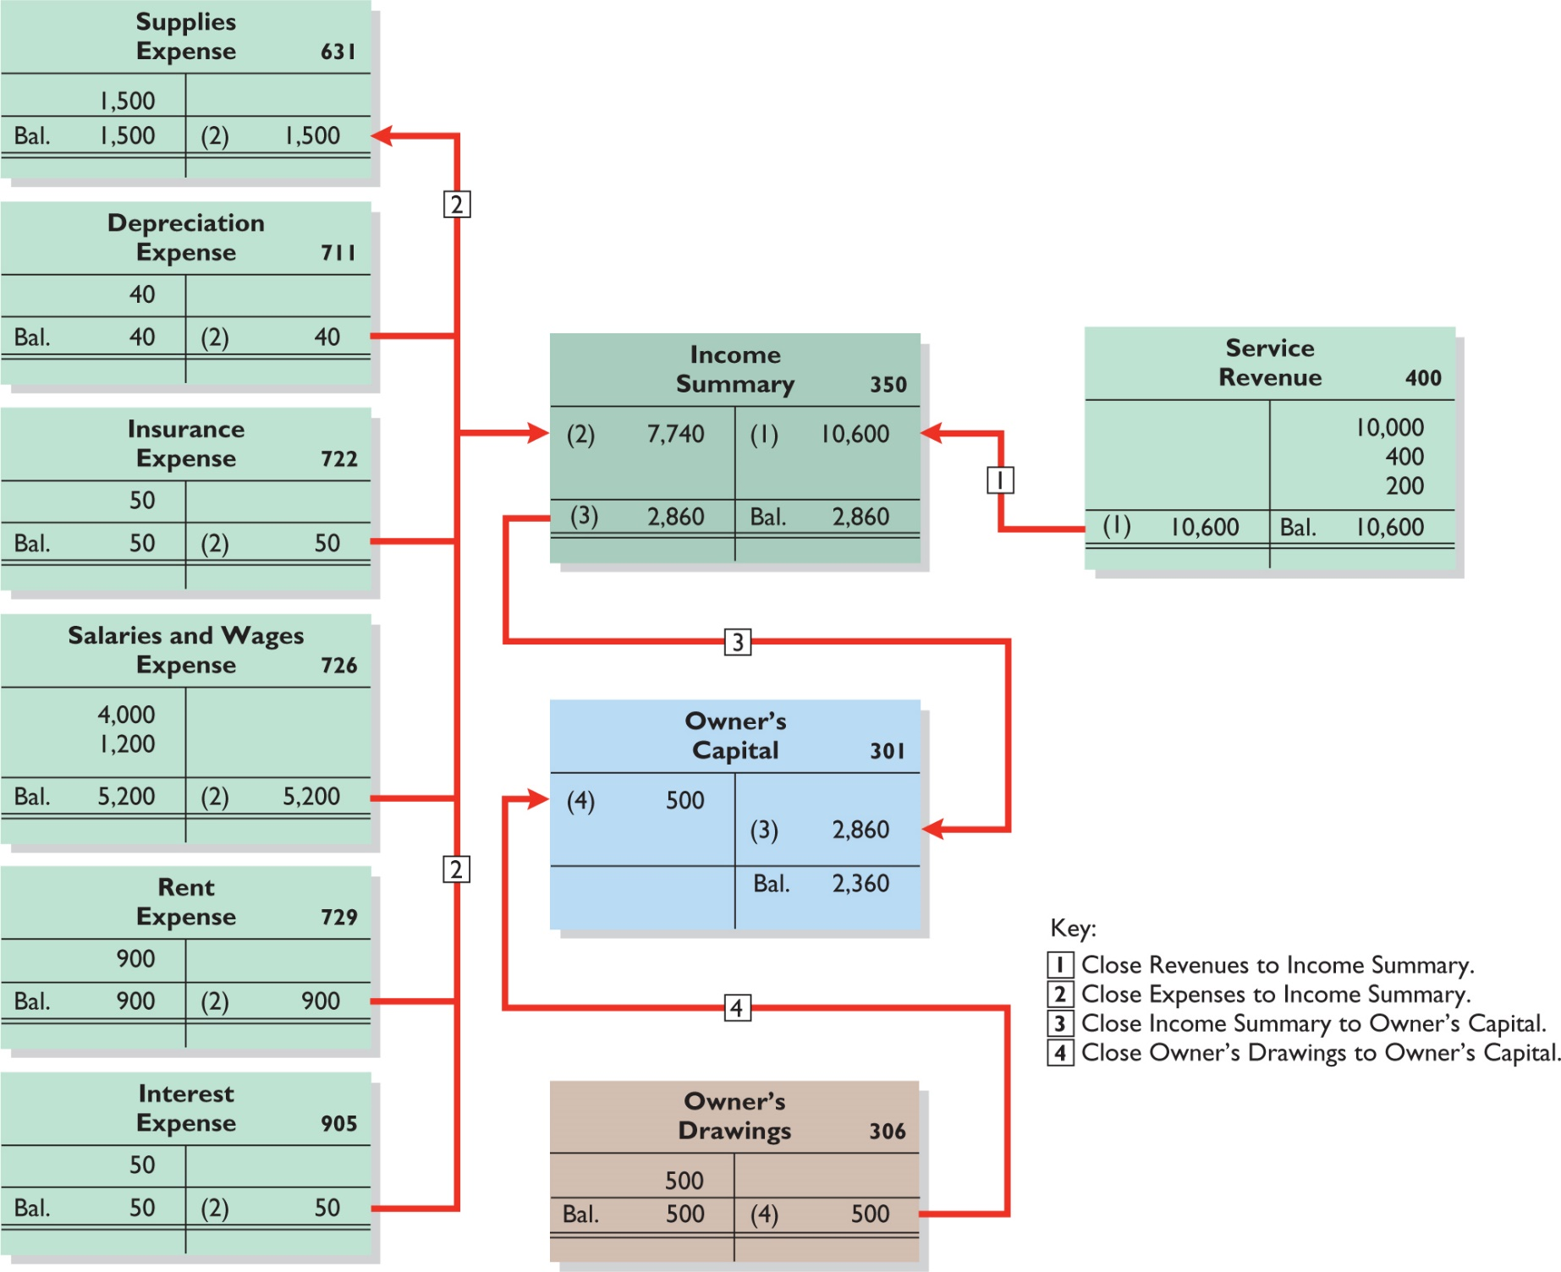
Posting Closing Entries
ILLUSTRATION 4.11
LO 2

Slide 26
Yazici Advertising Post-Closing Trial Balance October 31, 2020
 | Debit |  | Credit
Cash | ₺15,200
Accounts Receivable | 200
Supplies | 1,000
Prepaid Insurance | 550
Equipment | 5,000
Accumulated Depreciation |  |  | ₺ 40
Notes Payable |  |  | 5,000
Accounts Payable |  |  | 2,500
Unearned Service Revenue |  |  | 800
Salaries and Wages Payable |  |  | 1,200
Interest Payable |  |  | 50
Owner’s Capital |  |  | 12,360
 | ₺21,950 |  | ₺21,950
ILLUSTRATION 4.12
Post-Closing Trial Balance
LO 2

Slide 27
DO IT! 2 Closing Entries
Hancock Heating has the following balances in selected accounts of its adjusted trial balance.
Accounts Payable €27,000 Owner’s Drawings €15,000
Service Revenue 98,000 Owner’s Capital 42,000
Rent Expense 22,000 Accounts Receivable 38,000
Salaries and Wages Supplies Expense 7,000
Expense 51,000
Prepare the closing entries at December 31.
Service Revenue 98,000
Income Summary 98,000
LO 2

Slide 28
DO IT! 2 Closing Entries
Accounts Payable €27,000 Owner’s Drawings €15,000
Service Revenue 98,000 Owner’s Capital 42,000
Rent Expense 22,000 Accounts Receivable 38,000
Salaries and Wages Supplies Expense 7,000
Expense 51,000
Prepare the closing entries at December 31.
Income Summary 80,000
Salaries and Wages Expense 51,000
Rent Expense 22,000
Supplies Expense 7,000
LO 2

Slide 29
DO IT! 2 Closing Entries
Accounts Payable €27,000 Owner’s Drawings €15,000
Service Revenue 98,000 Owner’s Capital 42,000
Rent Expense 22,000 Accounts Receivable 38,000
Salaries and Wages Supplies Expense 7,000
Expense 51,000
Prepare the closing entries at December 31.
Income Summary 18,000
Owner’s Capital 18,000
Owner’s Capital 15,000
Owner’s Drawings 15,000
LO 2

Slide 30
The Accounting Cycle
1. Analyze business transactions
9. Prepare a post-closing trial balance
2. Journalize the transactions
8. Journalize and post closing entries
3. Post to ledger accounts
7. Prepare financial statements
4. Prepare a trial balance
6. Prepare an adjusted trial balance
5. Journalize and post adjusting entries
LO 3

Slide 31
1. Analyze Business Transactions
 |  | Assets |  |  |  | Liabilities |  |  |  |  |  | Owner’s Equity
Date |  | Cash | + | Equipment | = | Accounts Payable | + | Notes Payable | + | Unearned Revenue | + | Owner's Capital | - | Owner's Drawings | + | Revenue | - | Expense
1 |  | +₺10,000 |  |  |  |  |  |  |  |  |  | +₺10,000
1 |  |  |  | +₺5,000 |  |  |  | +₺5,000
2 |  | +1,200 |  |  |  |  |  |  |  | +₺1,200
3 |  | -1,200 |  |  |  |  |  |  |  |  |  |  |  |  |  |  |  | -₺1,200
4 |  |  |  |  |  | +250 |  |  |  |  |  |  |  |  |  |  |  | -₺250
Partial Schedule
LO 3

Slide 32
2. Journalize the Transactions
GENERAL JOURNAL |  |  |  | Page J1
Date | Explanation | Ref. | Debit | Credit
2020 Oct. 1 | Cash | 101 | 10,000
 | Owners’ Capital | 301 |  | 10,000
1 | Equipment | 157 | 5,000
 | Notes Payable | 200 |  | 5,000
2 | Cash | 101 | 1,200
 | Unearned Revenue | 209 |  | 1,200
3 | Rent Expense | 729 | 900
 | Cash | 101 |  | 900
LO 3
ILLUSTRATION 2.29

Slide 33
3. Post to the Ledger Accounts
Transaction |  | On October 1, C. R. Byrd invests ₺10,000 cash in an advertising company called Yazici Advertising.
Journal Entry |  | Date | Titles |  |  |  |  | Ref. | Debit | Credit
 |  | Oct. 1 | Cash |  |  |  |  | 101 | 10,000
 |  |  | Owner's Capital |  |  |  |  | 301 |  | 10,000
Posting |  | Cash 101 |  |  |  |  | Owner's Capital 301
 |  | Oct. 1 | 10,000 |  |  |  |  |  | Oct. 1 | 10,000
LO 3
ILLUSTRATION 2.19

Slide 34
4. Prepare a Trial Balance
Yazici Advertising Trial Balance October 31, 2020
 | Debit |  | Credit
Cash | ₺15,200
Supplies | 2,500
Prepaid Insurance | 600
Equipment | 5,000
Notes Payable |  |  | ₺ 5,000
Accounts Payable |  |  | 2,500
Unearned Service Revenue |  |  | 1,200
Owner’s Capital |  |  | 10,000
Owner’s Drawings | 500
Service Revenue |  |  | 10,000
Salaries and Wages Expense | 4,000
Rent Expense | 900
 | ₺28,700 |  | ₺28,700
LO 3

Slide 35
5. Journalize and Post Adjusting Entries
Transaction |  | Yazici used supplies costing ₺1,500.
Basic Analysis |  | The expense Supplies Expense is increased ₺1,500, and the asset Supplies is decreased ₺1,500.
Journal Entry |  | Date | Titles |  |  |  |  | Ref. | Debit | Credit
 |  | Oct. 31 | Supplies Expense |  |  |  |  |  | 1,500
 |  |  | Supplies |  |  |  |  |  |  | 1,500
Posting |  | Supplies |  |  |  |  | Supplies Expense
 |  | Oct. 5 | 2,500 | Oct. 31 | 1,500 |  | Oct. 31 | 1,500
 |  | Oct. 31 | 1,000 |  |  |  | Oct. 31 | 1,500
LO 3

Slide 36
6. Prepare an Adjusted Trail Balance
Yazici Advertising Adjusted Trial Balance October 31, 2020
 | Debit |  | Credit
Cash | ₺15,200
Accounts Receivable | 200
Supplies | 1,000
Prepaid Insurance | 550
Equipment | 5,000
Accumulated Depreciation—Equipment |  |  | ₺ 40
Notes Payable |  |  | 5,000
Accounts Payable |  |  | 2,500
Interest Payable |  |  | 50
Unearned Revenue |  |  | 800
Salaries and Wages Payable |  |  | 1,200
Owner’s Capital |  |  | 10,000
Owner’s Drawings | 500
Service Revenue |  |  | 10,600
Salaries and Wages Expense | 5,200
Supplies Expense | 1,500
Rent Expense | 900
Insurance Expense | 50
Interest Expense | 50
Depreciation Expense | 40
 | ₺30,190 |  | ₺30,190
ILLUSTRATION 3.25
LO 3

Slide 37
7. Prepare Financial Statements
Partial Statements
Yazici Advertising Income Statement For the Month Ended October 31, 2020
Revenues
Service revenue |  |  | ₺10,600
Yazici Advertising Owner’s Equity Statement For the Month Ended October 31, 2020
Owner’s capital, October 1 |  |  | ₺ 0
Yazici Advertising Statement of Financial Position October 31, 2020
Assets
Cash |  |  | ₺15,200
Accounts receivable |  |  | 200
LO 3

Slide 38
8. Journalize and Post Closing Entries
GENERAL JOURNAL |  |  |  | Page J3
Date | Account Titles and Explanations | Ref. | Debit | Credit
2020 Oct. 31 | Service Revenue | 400 | 10,600
 | Income Summary | 350 |  | 10,600
 | (To close revenue account)
31 | Income Summary | 350 | 7,740
 | Supplies Expense | 631 |  | 1,500
 | Depreciation Expense | 711 |  | 40
 | Insurance Expense | 722 |  | 50
 | Salaries and Wages Expense | 726 |  | 5,200
 | Rent Expense | 729 |  | 900
 | Interest Expense | 729 |  | 50
 | (To close expense accounts)
Partial Schedule
LO 3
ILLUSTRATION 4.10

Slide 39
9. Prepare a Post-Closing Trial Balance
Yazici Advertising Post-Closing Trial Balance October 31, 2020
 | Debit |  | Credit
Cash | ₺15,200
Accounts Receivable | 200
Supplies | 1,000
Prepaid Insurance | 550
Equipment | 5,000
Accumulated Depreciation |  |  | ₺ 40
Notes Payable |  |  | 5,000
Accounts Payable |  |  | 2,500
Unearned Service Revenue |  |  | 800
Salaries and Wages Payable |  |  | 1,200
Interest Payable |  |  | 50
Owner’s Capital |  |  | 12,360
 | ₺21,950 |  | ₺21,950
ILLUSTRATION 4.12
LO 3

Slide 40
Correcting Entries—An Avoidable Step
Unnecessary if accounting records are free of errors
Made whenever an error is discovered
Must be posted before closing entries
Instead of preparing a correcting entry, it is possible to reverse the incorrect entry and then prepare the correct entry.
LO 3

Slide 41
Correcting Entries—An Avoidable Step
Case 1: On May 10, Mercato Co. journalized and posted a NT$500 cash collection on account from a customer as a debit to Cash NT$500 and a credit to Service Revenue NT$500. The company discovered the error on May 20, when the customer paid the remaining balance in full.
Cash 500
Service Revenue 500
Cash 500
Accounts Receivable 500
Service Revenue 500
Accounts Receivable 500
Incorrect
entry
Correct
entry
Correcting entry
LO 3

Slide 42
Correcting Entries—An Avoidable Step
Case 2: On May 18, Mercato purchased on account equipment costing NT$4,500. The transaction was journalized and posted as a debit to Equipment NT$450 and a credit to Accounts Payable NT$450. The error was discovered on June 3,
Equipment 450
Accounts Payable 450
Equipment 4,500
Accounts Payable 4,500
Equipment 4,050
Accounts Payable 4,050
Incorrect
entry
Correct
entry
Correcting entry
LO 3

Slide 43
DO IT! 3 Correcting Entries
Sanchez Company discovered the following errors made in January 2020 (amounts in thousands).
A payment of Salaries and Wages Expense of INR600 was debited to Supplies and credited to Cash, both for INR600.
A collection of INR3,000 from a client on account was debited to Cash INR200 and credited to Service Revenue INR200.
The purchase of supplies on account for INR860 was debited to Supplies INR680 and credited to Accounts Payable INR680.
Correct the errors without reversing the incorrect entry.
LO 3

Slide 44
DO IT! 3 Correcting Entries
A payment of Salaries and Wages Expense of INR600 was debited to Supplies and credited to Cash, both for INR600.
Salaries and Wages Expense 600
Supplies 600
A collection of INR3,000 from a client on account was debited to Cash INR200 and credited to Service Revenue INR200.
Service Revenue 200
Cash 2,800
Accounts Receivable 3,000
LO 3

Slide 45
DO IT! 3 Correcting Entries
The purchase of supplies on account for INR860 was debited to Supplies INR680 and credited to Accounts Payable INR680.
Supplies (INR860 - INR680) 180
Accounts Payable 180
LO 3

Slide 46
Classified Statement of Financial Position
Presents a snapshot at a point in time
To improve understanding, companies group similar assets and similar liabilities together
Assets |  | Liabilities and Equity
Current assets |  | Equity
Long-term investments |  | Non-current liabilities
Property, plant, and equipment |  | Current liabilities
Intangible assets
ILLUSTRATION 4.20
Standard statement of financial position classifications
LO 4

Slide 47
Cheng Ltd. Statement of Financial Position October 31, 2020
Assets
Current assets
Cash |  |  | NT$ 6,600
Debt investments |  |  | 2,000
Accounts receivable |  |  | 7,000
Notes receivable |  |  | 1,000
Inventory |  |  | 3,000
Supplies |  |  | 2,100
Prepaid insurance |  |  | 400
Total current assets |  |  |  |  | NT$22,100
Long-term investments
Stock investments |  |  | 5,200
Investment in real estate |  |  | 2,000 |  | 7,200
Property, plant, and equipment
Land |  |  | 10,000
Equipment | NT$24,000
Less: Accumulated depreciation– equipment | 5,000 |  | 19,000 |  | 29,000
Intangible assets
Patents |  |  |  |  | 3,100
Total assets |  |  |  |  | NT$61,400
LO 4
ILLUSTRATION 4.21
Classified statement of financial position

Slide 48
Cheng Ltd. Statement of Financial Position October 31, 2020
Liabilities and Owner’s Equity
Current liabilities
Notes payable |  |  | NT$ 11,000
Accounts payable |  |  | 2,100
Unearned service revenue |  |  | 900
Salaries and wages payable |  |  | 1,600
Interest payable |  |  | 450
Total current liabilities |  |  |  |  | NT$16,050
Long-term liabilities
Mortgage payable |  |  | 10,000
Notes payable |  |  | 1,300
Total long-term liabilities |  |  |  |  | 11,300
Total liabilities |  |  |  |  | 27,350
Owner’s equity
Owner’s capital |  |  |  |  | 34,050
Total liabilities and owner’s equity |  |  |  |  | NT$61,400
LO 4
ILLUSTRATION 4.21
Classified statement of financial position

Slide 49
Intangible Assets
Long-lived assets that do not have physical substance
ILLUSTRATION 4.22
Nokia Statement of Financial Position (partial) (in millions)
Intangible assets
Capitalized development costs |  | € 244
Goodwill |  | 6,257
Other intangible assets |  | 3,913
 |  | €10,414
LO 4

Slide 50
Property, Plant, and Equipment
Long useful lives
Currently used in operations
Depreciation - allocating the cost of assets to a number of years
Accumulated depreciation - total amount of depreciation expensed thus far in the asset’s life
Sometimes called fixed assets or plant assets
LO 4

Slide 51
Property, Plant, and Equipment
Laclede Group Statement of Financial Position (partial) (₩ in billions )
Property, plant, and equipment
Land |  |  | ₩2,604
Buildings |  | ₩9,487
Structures |  | 1,568
Machinery |  | 36,956
Vehicles |  | 226
Other |  | 10,600 | 58,837
Less: Accumulated depreciation |  |  | 32,617
 |  |  | ₩28,824
ILLUSTRATION 4.23
LO 4

Slide 52
Long-Term Investments
Investments in stocks and bonds of other companies
Investments in non-current assets such as land or buildings that are not currently being used in operating activities
Long-term notes receivable
ILLUSTRATION 4.24
Alphabet Inc. Statement of Financial Position (partial) (in thousands)
Long-term investments
Non-marketable equity investments |  | $1,469
LO 4

Slide 53
Current Assets
Assets that a company expects to convert to cash or use up within one year or the operating cycle, whichever is longer
Operating cycle is the average time that it takes to
purchase inventory,
sell it on account, and
collect cash from customers
LO 4

Slide 54
Current Assets
ILLUSTRATION 4.25
Tesco Statement of Financial Position (partial) (£ in millions)
Current assets
Inventories |  | £2,430
Trade and other receivables |  | 1,311
Derivative financial instruments |  | 97
Current tax assets |  | 6
Short-term investments |  | 360
Cash and cash equivalents |  | 1,788
Total current assets |  | £5,992
Accounts usually listed in order liquidity.
LO 4

Slide 55
Current Assets
The correct order of presentation in a classified statement of financial position for the following current assets is:
accounts receivable, cash, prepaid insurance, inventory.
prepaid insurance, inventory, accounts receivable, cash.
cash, accounts receivable, inventory, prepaid insurance.
inventory, cash, accounts receivable, prepaid insurance.
LO 4

Slide 56
Owner’s Equity
Proprietorship - one capital account
Partnership - capital account for each partner
Corporation - Common Stock and Retained Earnings
Halie Capital Ltd. Statement of Financial Position (partial) (in thousands)
Equity
Share capital |  | £ 685,934
Retained earnings |  | 1,406,747
Total equity |  | £2,092,681
ILLUSTRATION 4.26
LO 4

Slide 57
Non-Current Liabilities
Obligations a company expects to pay after one year.
Siemens Statement of Financial Position (partial) (in millions)
Non-current liabilities
Long-term debt |  | € 14,260
Pension plans and similar commitments |  | 4,361
Provisions |  | 2,533
Deferred tax liabilities |  | 726
Other non-current liabilities |  | 2,752
 |  | €24,632
ILLUSTRATION 4.27
LO 4

Slide 58
Current Liabilities
Obligations company is to pay within coming year or its operating cycle, whichever is longer
Usually list notes payable first, followed by accounts payable. Other items follow in order of magnitude
Common examples are accounts payable, salaries and wages payable, notes payable, interest payable, income taxes payable, current maturities of long-term obligations
Liquidity - ability to pay obligations expected to be due within the next year
LO 4

Slide 59
Current Liabilities
Siemens Statement of Financial Position (partial) (in millions)
Current liabilities
Trade payables |  | € 8,860
Current provisions |  | 5,165
Other current financial liabilities |  | 2,427
Income taxes payable |  | 1,970
Current maturities for long-term debt |  | 1,819
Other current liabilities |  | 22,210
 |  | €42,451
ILLUSTRATION 4.28
LO 4

Slide 60
Classified Statement of Financial Position
Patents and copyrights are
Current assets
Intangible assets
Long-term investments
Property, plant, and equipment
LO 4

Slide 61
Classified Statement of Financial Position
Which of the following is not a non-current liability?
Bonds payable
Current maturities of long-term obligations
Long-term notes payable
Mortgages payable
LO 4

Slide 62
DO IT! 4 Statement of Financial Position Classifications
Match each of the following to its proper statement of financial position classification, shown below. If the item would not appear on a statement of financial position, use “NA.”
CL | Salaries and wages payable |  | LTI | Stock investments (long-term)
NA | Service revenue |  | PPE | Equipment
CL | Interest payable |  | PPE | Accumulated depreciation
IA | Goodwill |  | NA | Depreciation expense
CA | Debt investments (short-term) |  | OE | Owner’s capital
NCL | Mortgage payable (due in 3 years) |  | CL | Unearned service revenue
Current assets (CA) |  |  | Current liabilities (CL)
Long-term investments (LTI) |  |  | Non-current liabilities (NCL)
Property, plant, and equipment (PPE) |  |  | Owner’s equity (OE)
Intangible assets (IA)
LO 4

Slide 63
Appendix 4A Reversing Entries
It is often helpful to reverse some adjusting entries before recording regular transactions of the next period
Companies make a reversing entry at beginning of next accounting period
Each reversing entry is exact opposite of adjusting entry made in previous period
Use of reversing entries does not change amounts reported in the financial statements
LO 5

Slide 64
Reversing Entries Example
We use the salaries expense transactions for Yazici Advertising as illustrated in Chapters 2, 3, and 4.
October 26 (initial salary entry): Yazici pays ₺4,000 of salaries and wages earned between October 15 and October 26.
October 31 (adjusting entry): Salaries and wages earned between October 29 and October 31 are ₺1,200. The company will pay these in the November 9 payroll.
November 9 (subsequent salary entry): Salaries and wages paid are ₺4,000. Of this amount, ₺1,200 applied to accrued salaries and wages payable and ₺2,800 was earned between November 1 and November 9.
LO 5

Slide 65
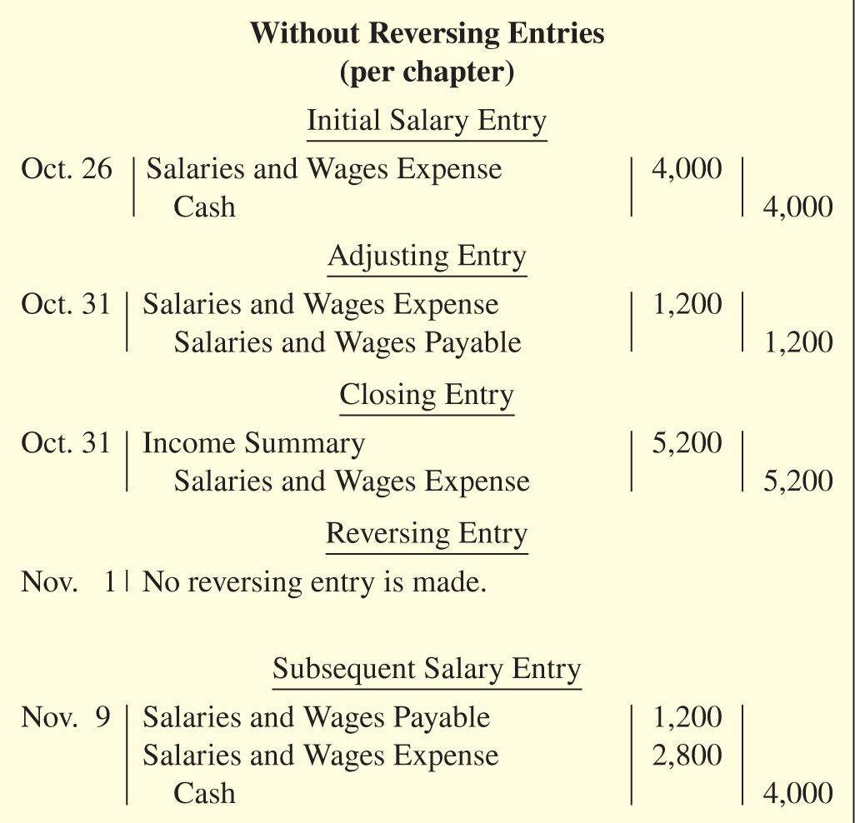
Reversing Entries Example
ILLUSTRATION 4A.1
With Reversing Entries (per appendix)
Initial Salary Entry
Oct. 26 Same entry
Adjusting Entry
Oct. 31 Same entry
Closing Entry
Oct. 31 Same entry
Reversing Entry
Nov. 1
Salaries and Wages Payable 1,200
Salaries and Wages Expense 1,200
Subsequent Salary Entry
Nov. 9
Salaries and Wages Expense 4,000
Cash 4,000
LO 5

Slide 66
Reversing Entries Example
ILLUSTRATION 4A.2
Postings with reversing entries
Salaries and Wages Expense
10/26 Paid | 4,000 | 10/31 Closing | 5,200
10/31 Adjusting | 1,200
11/9 Paid | 5,200 | 11/1 Reversing | 1,200
Salaries and Wages Payable
11/1 Reversing | 1,200 | 10/31 Adjusting | 1,200
LO 5

Slide 67
A Look at U.S. GAAP
Key Points
Similarities
The procedures of the closing process are applicable to all companies, whether they are using IFRS or GAAP.
IFRS generally requires a classified statement of financial position similar to the classified balance sheet under GAAP.
IFRS follows the same guidelines as GAAP for distinguishing between current and non-current assets and liabilities.
LO 6

Slide 68
A Look at U.S. GAAP
Key Points
Differences
IFRS officially uses the term statement of financial position in its literature, while in the United States it is often referred to as the balance sheet.
IFRS requires that specific items be reported on the statement of financial position, whereas no such general standard exists in GAAP.
While IFRS companies often report non-current assets before current assets in their statements of financial position, this is never seen under GAAP.
LO 6

Slide 69
A Look at U.S. GAAP
Key Points
Differences
Under IFRS, current assets are usually listed in the reverse order of liquidity. For example, under GAAP cash is listed first, but under IFRS it is listed last.
GAAP has many differences in terminology from what are shown in your textbook.
Both GAAP and IFRS are increasing the use of fair value to report assets. However, at this point IFRS has adopted it more broadly. As examples, under IFRS, companies can apply fair value to property, plant, and equipment, and in some cases intangible assets.
LO 6

Slide 70
A Look at U.S. GAAP
Looking to the Future
The IASB and the FASB are working on a project related to financial statement presentation. A key feature of the proposed framework is that each of the statements will be organized in the same format, to separate an entity’s financing activities from its operating and investing activities and, further, to separate financing activities into transactions with owners and creditors. Thus, the same classifications used in the statement of financial position would also be used in the income statement and the statement of cash flows.
LO 6

Slide 71
Copyright
Copyright © 2019 John Wiley & Sons, Inc.
All rights reserved. Reproduction or translation of this work beyond that permitted in Section 117 of the 1976 United States Act without the express written permission of the copyright owner is unlawful. Request for further information should be addressed to the Permissions Department, John Wiley & Sons, Inc. The purchaser may make back-up copies for his/her own use only and not for distribution or resale. The Publisher assumes no responsibility for errors, omissions, or damages, caused by the use of these programs or from the use of the information contained herein.

